Slide 1
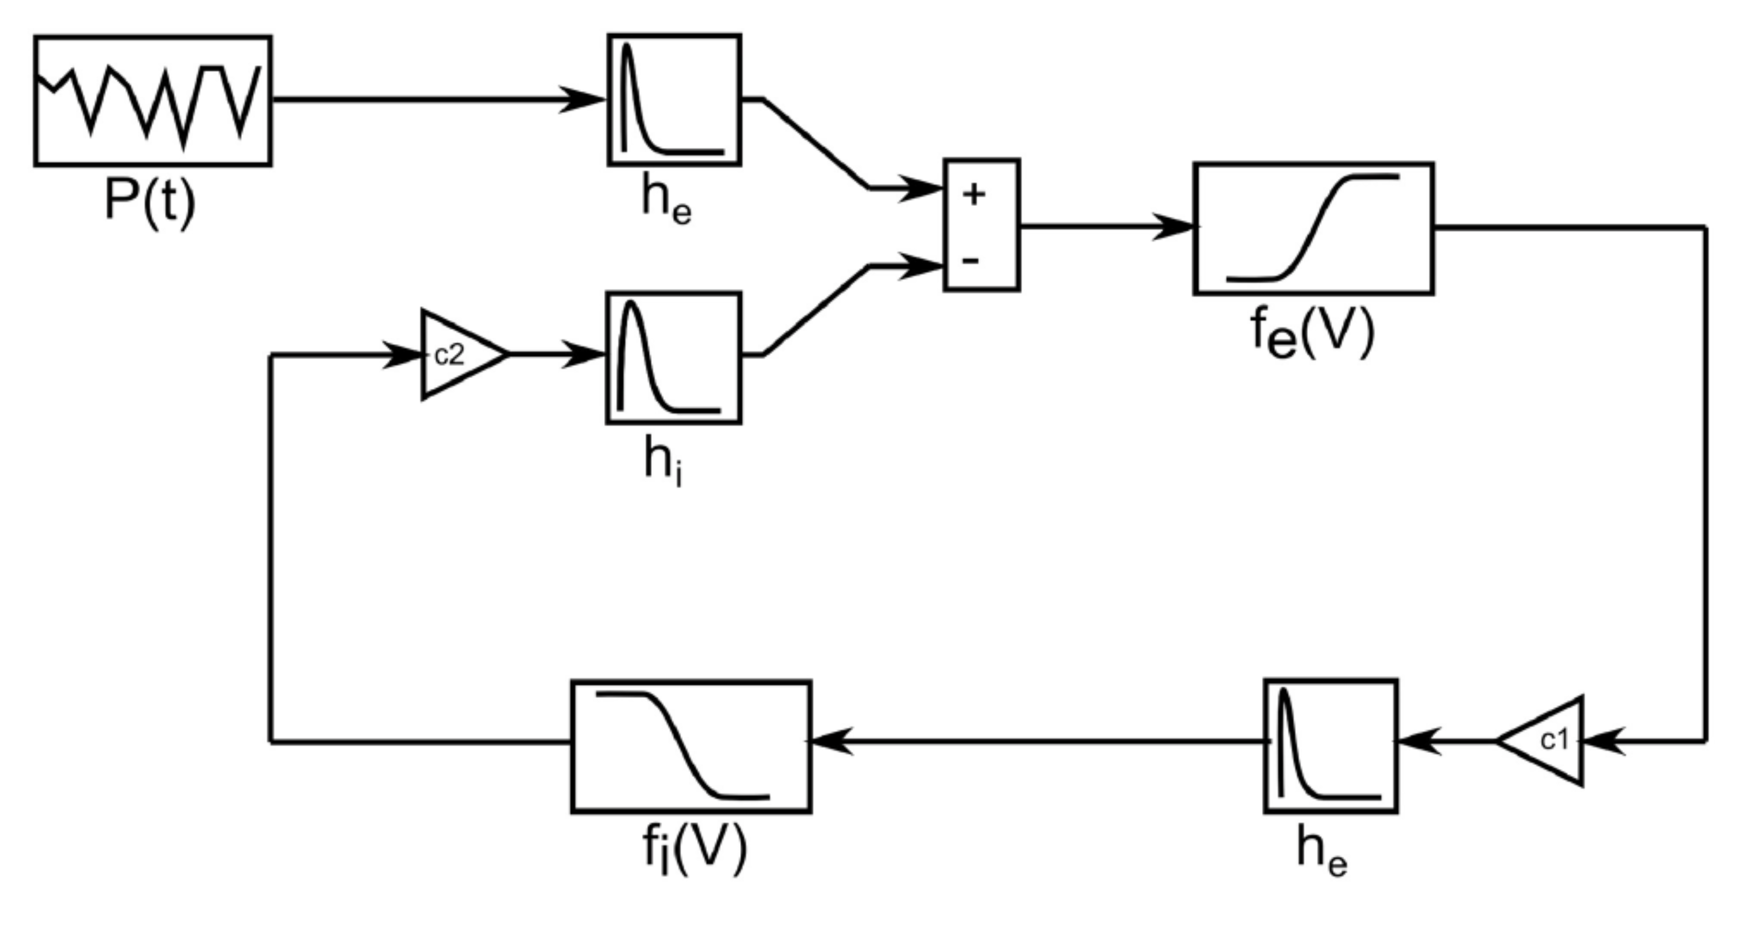
Jan Freyberg ¹, Owen Parsons ², Richard Bethlehem ², Sarah Crockford ³, Simon Baron-Cohen ²
1: Forensic and Neurodevelopmental Sciences, King’s College London; 2: Autism Research Centre, University of Cambridge; 3: University College London
Equivalent non-linear responses to steady-state stimulation in autism
github.com/janfreyberg/non-linear-frequencies
Introduction
When a subject is visually stimulated at a specific frequency (f₀), a power-spectrum analysis of EEG recordings reveals a marked peak at that frequency. Often called steady-state visually evoked potentials (SSVEPs), this response also features non-linear responses to stimulation at f₀: harmonics (f₀×n) and sub-harmonics (f₀/n, Vialatte et al, 2010)
In a recent paper, Labecki and colleagues (2016) constructed a neural mass model which featured neurons with an oscillating input and an inhibitory feedback loop (Figure 1). They found that removing the inhibitory feedback drastically reduced the amplitude of (sub)-harmonic frequencies in the system.
Given that reductions in inhibitory signalling are considered to be a likely feature of various psychiatric conditions, we wanted to measure the amplitude of (sub-)harmonic frequencies in one group which is commonly considered to have reduced inhibitory signalling: autism spectrum conditions (Rubenstein and Merzenich, 2003).
Model Data
We modelled changes in inhibitory signalling by modifying the gain term between the inhibitory and excitatory neurons (c2), running the model at 41 values, ranging from 0 to 12 in steps of 0.3, including the physiologically derived standard value of 3.
We measured the amplitude of non-linear frequencies in the model by performing a fourier transform on the excitatory cell potentials and averaging the power at the first three harmonic and subharmonic frequencies.
We found that when deviating from the physiologically derived value for inhibitory gain (c2 = 3), either by increasing or decreasing gain, the power at non-linear frequencies decreased. This indicates that individuals with reduced inhibitory signalling should show reduced non-linear frequency responses.
Experimental Data
We recruited 14 patients with autism and 32 control participants. We elicited SSVEPs in these participants using contrast-reversing gratings.
The gratings had a spatial frequency of 2 cycles per degree of visual angle, and subtended a circular area of 12 degrees of visual angle. Gratings were angled at either -45° or +45°, and flickered at either 28.8Hz or 36Hz. Participants viewed 16 trials of 8s, counterbalanced for orientation and frequency.
EEG data was recorded at 1024 Hz using a 64-channel BioSemi active electrode system.
We found similar power at (sub-)harmonics of 28.8Hz and 36Hz in the two groups, with no statistically significant difference in means (p > 0.138).
Summary
When visually stimulated at a given frequency, a power analysis of activity in the visual system reveals strong responses at the stimulation frequency and at sub- and harmonic frequencies.
Our computational model suggests that reductions or increased in inhibitory signalling produces a reduced amplitude of non-linear frequency responses. Autism is often thought to be characterised by reduced inhibitory activity.
However, we find no difference in non-linear frequency activity between control subjects and autism subjects.
This could indicate that:
EEG-recorded SSVEPs are not sensitive enough to resolve a possible group difference.
There is no group difference in inhibitory signalling in this sample.
The computational model used to make these predictions did not accurately portray what occurs when inhibition changes.
References
Rubenstein, J.L.R., and Merzenich, M.M. (2003). Model of autism : increased ratio of excitation / inhibition in key neural systems. Genes, Brain and Behaviour 2, 255–267.
Vialatte, F.-B., Maurice, M., Dauwels, J., and Cichocki, A. (2010). Steady-state visually evoked potentials: Focus on essential paradigms and future perspectives. Progress in Neurobiology 90, 418–438.
Labecki, M., Kus, R., Brzozowska, A., Stacewicz, T., Bhattacharya, B.S., and Suffczynski, P. (2016). Nonlinear Origin of SSVEP Spectra—A Combined Experimental and Modeling Study. Front Comput Neurosci 10.
Figure 1: The neural mass model by Labecki et al. (2016), with oscillating input on the top left, and a feedback loop of excitatory and inhibitory neurons.
Figure 2: The amplitude of non-linear frequencies in the model decreases with deviation from the physiologically derived value, indicating that changes in inhibitory strength would produce reductions in non-linear frequency power.
Figure 3: The amplitude of non-linear frequencies is similar in the control and autism groups. Error bars indicate 1 SEM. We found similar amplitudes of non-linear frequencies in the two groups, with no statistically significant difference.

